Slide 1
205 Nov 4, Class 17
Chapter 15: Survey & instrument design
Plant et al. (2009), The Obama Effect

Slide 2
Polling data
A new York Times/Siena poll of the national electorate from 10/20/24 to 10/23/24 finds the race for president to be a statistical tie
  48% - 48%
How do they “know” that?
  Transparency: full methodology is posted as additional information together with the poll

Slide 3
Poll Methodology
Interviewers spoke with 2,516 voters nationwide from Oct. 20 to 23, 2024.
Times/Siena polls are conducted by telephone, using live interviewers, in both English and Spanish. Overall, 98 percent of respondents were contacted on a cellphone for this poll.
Voters are selected for the survey from a list of registered voters. The list contains information on the demographic characteristics of every registered voter, allowing us to make sure we reach the right number of voters of each party, race and region. For these polls, interviewers placed more than 260,000 calls to more than 80,000 voters.
To further ensure that the results reflect the entire voting population, not just those willing to take a poll, we give more weight to respondents from demographic groups that are underrepresented among survey respondents, like people without a college degree. You can see more information about the characteristics of our respondents and the weighted sample at the bottom of the page, under “Composition of the Sample.”

Slide 4
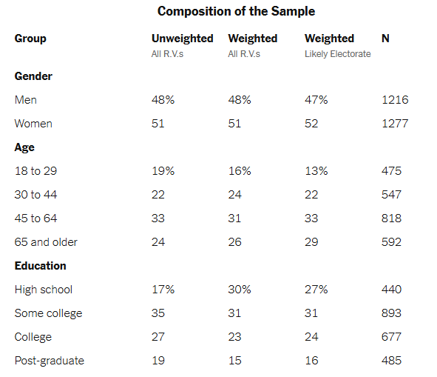
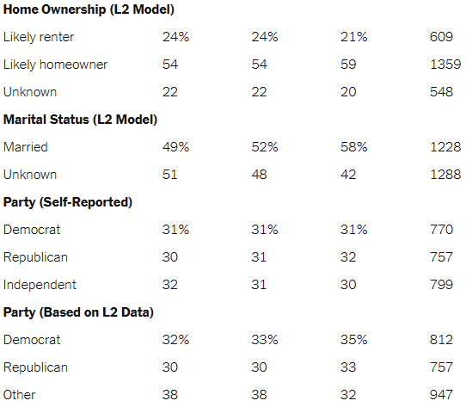

Slide 5
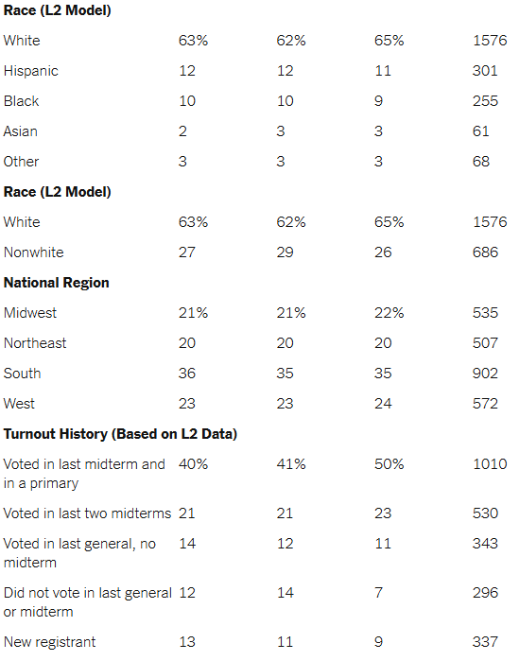

Slide 6
Polling challenges
260,000 calls -> 80,000 voters -> 2,516 responses
  Non-response bias?
Statistical modeling adjusts the observed data to match expectations about the statistical makeup of voters
Margin of “sampling error” is 2.2%
  If the model is correct, error could be much higher otherwise
  “Historically, The Times/Siena Poll’s error at the 95th percentile has been plus or minus 5.1 percentage points in surveys taken over the final three weeks before an election. Real-world error includes sources of error beyond sampling error, such as nonresponse bias, coverage error, late shifts among undecided voters and error in estimating the composition of the electorate.”

Slide 7
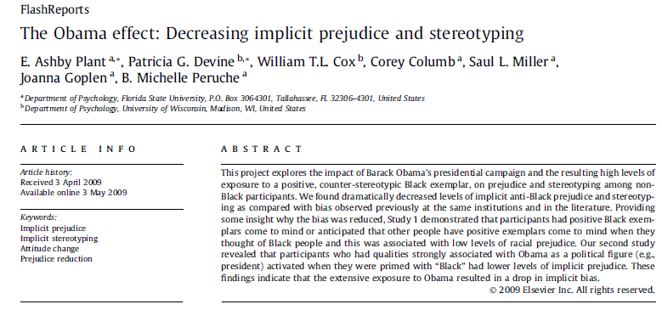

Slide 8
Evaluative IAT. The IAT is a dual categorization task in which participants categorize words as pleasant or unpleasant and faces as either Black or White by pressing one of two keys on the computer keyboard. Stimuli consisted of pleasant and unpleasant words as used by Greenwald et al. (1998) and pictures of White and Black male faces displaying neutral expressions (Malpass, Lavigueur, & Weldon, 1973) as used by Devine, Plant, Amodio, Harmon-Jones, and Vance (2002; Study 3). Pleasant words included honor, lucky, diamond, loyal, freedom, rainbow, love, honest, peace, and heaven. Unpleasant words included evil, cancer, sickness, disaster, poverty, vomit, bomb, rotten, abuse, and murder

Slide 9
IAT
Block 1: Is this word good or bad?
Block 2: Is this face black or white?
Blocks 3-4: Mixed together, compatible
  Same hand for good/white, bad/black
Block 5: Mixed, incompatible
DV = RT on block 5 – average on 3 & 4

Slide 10
IAT Design
Aimed at overcoming response bias inherent in asking about racial stereotype/attitudes
  Surveys can produce inaccurate data
Demonstrates the concept of ‘implicit’ elements of cognition
  Unintentional bias
DV is fairly noisy
  Can exhibit poor test-retest reliability

Slide 11
Non-experimental research
“The goal of this project was to explore whether Obama’s historic presidential campaign and the resulting high levels of exposure to a positive, counter-stereotypic Black exemplar led to reduced racial prejudice and stereotyping.”
Q1. Can we be confident about the causal direction here? Why or why not?
Q2. Give an alternate interpretation of the data. The interpretation must be with the data as observed (not an alternate outcome) but is a different inference.

Slide 12
Additional questions
Why could this research only be done non-experimentally?
If the authors interpretation of the effect is correct, what subsequent recent historic events might we see as having similar types of effects and what might these be?
What principle of survey question design is implicit in the procedure of the IAT?

Slide 13
Surveys & Instrument Design
Survey
  Series of questions, often with a simple numerical response scale
  Often used in non-experimental research
  Relationships among responses used for sociology, economics, epidemiology
Instrument
  Established series of questions to quantify a construct
  Operational definitions
    Happiness, depression
    Personality measures
    IQ

Slide 14
Survey research
Quality and effectiveness of questions
  Demand characteristics
  Complex or double-barreled questions
Sampling methodology
  Recruiting bias
  Participation/Non-response bias
  Inaccurate responses

Slide 15
Bias
1. What is meant by “selection bias” in the context of survey research?
  a. The survey participants are not randomly chosen from the population.
  b. The survey participants are randomly chosen from the population.
  c. The survey participants are not part of the population of interest.
  d. The survey participants are a part of the population of interest.

Slide 16
2. Which bias occurs when individuals who were contacted chose to complete the survey differ in some ways from others who were contacted but chose not to take the survey?
  a. Response set
  b. Non-response
  c. Attrition
  d. Motivated respondent

Slide 17
Explain how each of the following two questions are examples of “double-barreled” questions:
  Please agree or disagree with the following statement: Cars should be faster and safer.
  How satisfied are you with your pay and job conditions?

Slide 18
Instrument development
Reliability measures
  Test-retest reliability: for measures that are hypothesized to be stable over time
  Inter-item reliability: statistical tools for assessing relationships among items supposed to tap the same constructs
Validity measures
  Construct/Face validity
  Convergent validity with existing measures
  Discriminant validity versus existing measures

Slide 19
Writing Effective Questions
BRUSO
  Brief
  Relevant
  Unambiguous
  Specific
  Objective

Slide 20
How Happy Are You?
How do we turn happiness into a number?
  Operational definition
Online survey:
  https://www.happiness-survey.com/

Slide 21
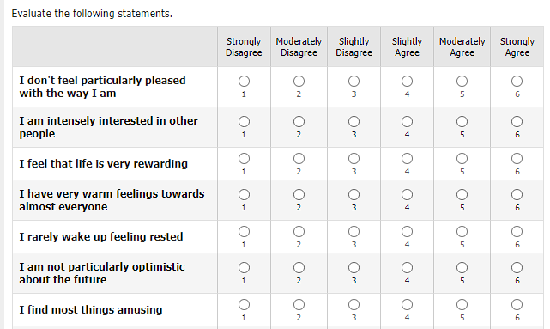
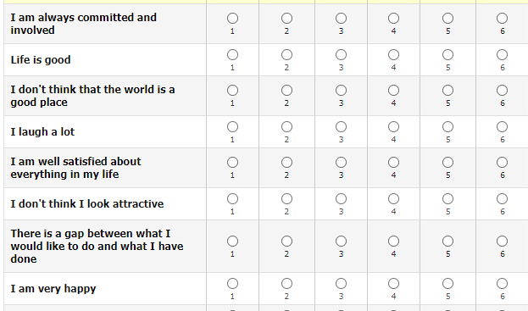
OHQ online survey

Slide 22
Oxford Happiness Questionnaire
INSTRUCTIONS. Below are a number of statements about happiness. Would you please indicate how much you agree or disagree with each by entering a number alongside it according to the following code:
1=strongly disagree; 2=moderately disagree; 3=slightly disagree; 4=slightly agree; 5=moderately agree; 6=strongly agree.
  I feel that life is very rewarding
  I am well satisfied about everything in my life
  I don't feel particularly pleased with the way I am (−)

Slide 23
Using an existing scale
Follow the directions in the publication that describes and establishes scale validity
Note varieties: 29 items or 8 (short form)
Use all items in form selected
  Following scoring procedure
  Flip reverse items
  Usually sum, sometimes weighting
Hills, P., & Argyle, M. (2002). The Oxford Happiness Questionnaire: a compact scale for the measurement of psychological well-being. Personality and individual differences, 33(7), 1073-1082.

Slide 24
For Wed Nov 6
Read Stephens et al. (2009)
  Answer questions on Canvas

